Slide 1
Computer Science 20
Summary quiz practice questions

Slide 2
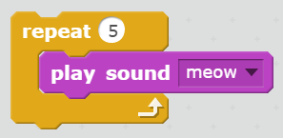

When the following script is run, how many times will you hear the “meow” sound?
A: One. Anytime there is a block that includes an “until done” version as well, it implies that the main version doesn’t wait for the instruction to finish before moving on to the next thing in the script.

Slide 3
In Scratch, there are only 2 types of data (information) that can be stored in variables. What are these two types?
A: Numeric Any type of number, can be used mathematically
String Any set of alphanumeric characters (“Hello”, “Apple123”) Can’t be used mathematically

Slide 4
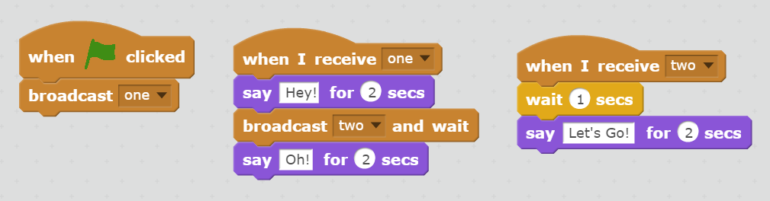
When the green flag is clicked, what will the follow script do?
A: the sprite will say: ”Hey!” followed by a pause and “Lets Go”, then finally “Oh!”.
The broadcast signals control when each script is triggered, and since Broadcast and wait is used, the final “Oh!” won’t be said until the “When I receive two” script has finished completely.

Slide 5
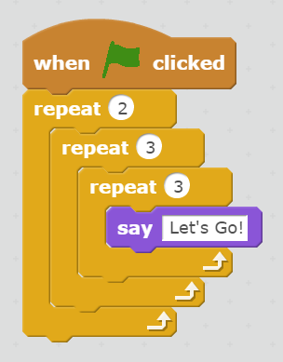
When the green flag is clicked, How many times will the say “Let’s Go” block be repeated?
A: 18
First look at the two inside loops. Three times, the block say “Let’s Go!” will be repeated three times: 3 x 3 = 9
The outermost loop says to repeat the inner loop contents twice:
2 x 9 = 18

Slide 6
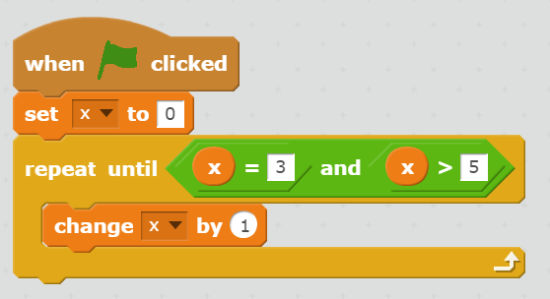
When the following script is complete, what will be value of x be?
A: This script will never complete (infinite loop)
The condition of the loop will never evaluate to true, as the value of x can’t be both equal to 3 and greater than 5 at the same time. The value of x will continue getting larger until the user stops the program.

Slide 7
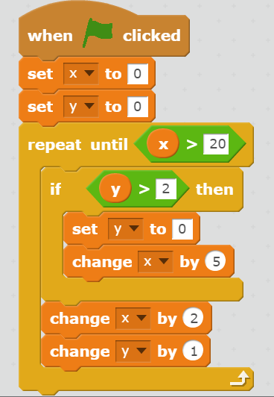
When the following script is complete, what will be value of x be?
A: 24
For more complex problems, drawing a table to track the values across iterations is a good strategy.
Iteration # | Value of X | Value of Y
1 | 0 | 0
2 | 2 | 1
3 | 4 | 2
4 | 6 | 3
5 | 11 + 2 = 13 | 0 + 1 = 1
6 | 15 | 2
7 | 17 | 3
8 | 22 + 2 = 24 | 0 + 1 = 1

